Slide 1
Employee Data Analysis using Excel
STUDENT NAME: Tharun Kumar TR
REGISTER NO:
DEPARTMENT: Bachelor of Commerce
COLLEGE: scp jain college

Slide 2
PROJECT TITLE
Employee Performance Analysis using Excel

Slide 3


AGENDA
Problem Statement
Project Overview
End Users
Our Solution and Proposition
Dataset Description
Modelling Approach
Results and Discussion
Conclusion
3/21/2024 Annual Review

Slide 4

PROBLEM STATEMENT
The goal of analyzing the Synthetic Employee Records Dataset is to utilize data analysis and machine learning methods to enhance employee management practices.
By exploring this dataset, we aim to uncover patterns and trends related to employee performance, employment status, and demographic characteristics.
This analysis will provide insights into the factors affecting employee performance, facilitate the optimization of workforce management, and enhance overall organizational efficiency..

Slide 5

PROJECT OVERVIEW
Employee data analysis involves the examination and interpretation of data pertaining to employees within an organization.
This process includes evaluating various facets of employee records, such as performance metrics, demographic details, employment status, and job roles.
The objective is to identify trends, patterns, and correlations that can offer insights into workforce dynamics, guide HR strategies, and enhance organizational effectiveness.
By recognizing these patterns, organizations can make informed, data-driven decisions to improve employee satisfaction, optimize performance, and proactively address potential issues.

Slide 6







WHO ARE THE END USERS?
Employees
Data Analysts/Scientists
Business Leaders/Managers
Consultants
Policy Makers
Compliance Officers
Organisation

Slide 7

OUR SOLUTION AND ITS VALUE PROPOSITION
Conditional Formatting
This feature highlights any missing or incomplete data within the dataset, ensuring data integrity and enabling quick identification of data gaps for accurate analysis.
Filter
The filter function removes irrelevant or redundant data from the dataset, streamlining the analysis process by focusing on relevant information and enhancing the clarity of insights.
Formula (Performance)
Formulas are used to calculate and evaluate employee performance metrics, automating the assessment of performance levels. This allows for consistent and objective evaluations of employee performance.

Slide 8
Pivot Summary
This feature summarizes large datasets by grouping and aggregating data points, providing a comprehensive overview of employee performance trends. It enables strategic decision-making by highlighting key insights.
Graph (Data Visualization)
Data visualization transforms data trends and patterns into charts and graphs. This approach facilitates the interpretation of complex data, making insights more accessible and actionable for informed decision-making.

Slide 9
Dataset Description
The Synthetic Employee Records Dataset, obtained from Kaggle, is a simulated dataset aimed at exploring data analysis and machine learning techniques in the realm of human resources and employee management. It consists of 26 features, of which 9 have been selected for analysis.
Key columns in the dataset include the Employee ID, presented as a numeric value, along with the Employee's first and last names, recorded as text. Employees are categorized by type, and their performance levels are assessed using an IFS formula. Additionally, gender is represented as either Male or Female, while employee ratings are displayed as numerical values.

Slide 10

THE "WOW" IN OUR SOLUTION
Advanced Performance Evaluation with IFS Formula
Implemented an IFS formula to dynamically categorize employee performance based on their Performance Score. The formula used is: IFS(Z8>=5, "VERY HIGH", Z8>=4, "HIGH", Z8>=3, "MED", TRUE, "LOW"). This approach ensures that each performance score is accurately and efficiently translated into performance categories: Very High, High, Medium, and Low.
Constructed a Pivotal Table
Developed a Pivotal Table to summarize and analyze employee performance data. This table provides a clear and concise overview of performance metrics, facilitating quick insights and decision-making.
3/21/2024 Annual Review
‹#›

Slide 11
Interactive Data Exploration with Slicer
A Slicer has been integrated into the data analysis process to facilitate interactive filtering and exploration of the dataset. This feature enhances user experience by allowing users to easily filter data based on various criteria, such as performance level, department, or employee type.
Visual Representation with Clustered Column Chart
A Clustered Column Chart has been employed to visually depict the distribution of performance levels across different categories. This chart aids in identifying patterns and trends in employee performance, making it simpler to interpret and present findings.

Slide 12
MODELLING
Data Collection
The dataset was obtained from Kaggle, which involved creating a Kaggle account, navigating to the dataset page, and using either the download button or the Kaggle API to access the dataset files. A review of the dataset's description and metadata was conducted to understand its structure and identify any specific considerations or limitations.
Feature Collection
The dataset contains 26 features, of which 9 have been selected for analysis. Key columns include:
- Employee ID
- Employee First and Last Names
- Business Unit
- Employee Status
- Employee Type
- Employee Classification Type
- Gender Code
- Performance Score
- Current Employee Rating
‹#›

Slide 13
Data Cleaning
Conditional formatting was utilized to identify missing values in the dataset. A rule was set up to format cells containing null or blank values, which were highlighted in red. This visual cue made it easy to spot and address the missing data.
The filtering feature was employed to isolate rows with missing values. Once these rows were identified, they were removed from the dataset. This process ensured that the dataset was complete and ready for further analysis, maintaining its quality and reliability.
Advanced Performance Evaluation with IFS Formula
Implemented an IFS formula to dynamically categorize employee performance based on their Performance Score.
The formula used is: IFS(Z8>=5, "VERY HIGH", Z8>=4, "HIGH", Z8>=3, "MED", TRUE, "LOW").

Slide 14
Visualization
Developed a Pivotal Table to summarize and analyze employee performance data.
Incorporated a Slicer in the data analysis process to enable interactive filtering and exploration of the dataset.
Utilized a Clustered Column Chart to visually represent the distribution of performance levels across different categories.

Slide 15
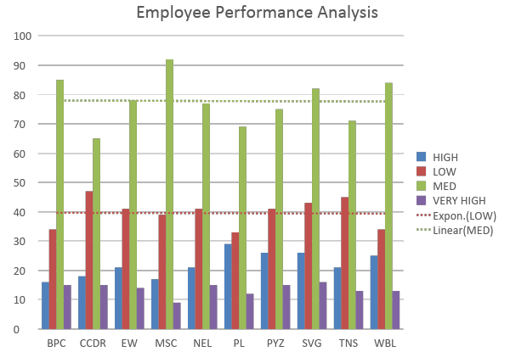
RESULTS
‹#›

Slide 16
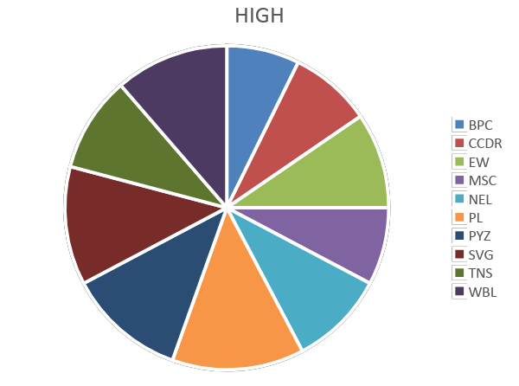

Slide 17
Conclusion
The Synthetic Employee Records Dataset offers a solid framework for exploring human resources and employee management through data analysis and machine learning. Featuring a diverse array of fields, such as Employee Status, Employee Type, and Performance Score, this dataset allows for thorough evaluations of employee performance and organizational dynamics.
By employing analytical techniques like the IFS formula for performance categorization, pivot tables for data summarization, and visual tools like clustered column charts, one can extract actionable insights into workforce trends. Overall, this dataset serves as an invaluable resource for developing strategies that enhance employee management and optimize organizational performance.

